Slide 1
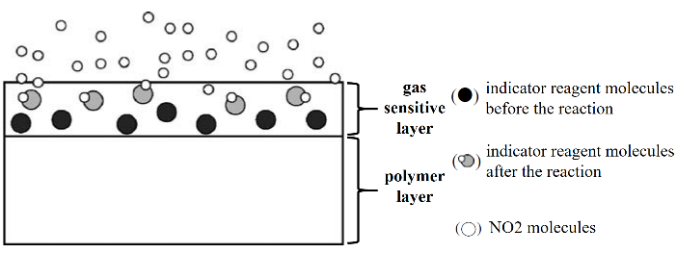
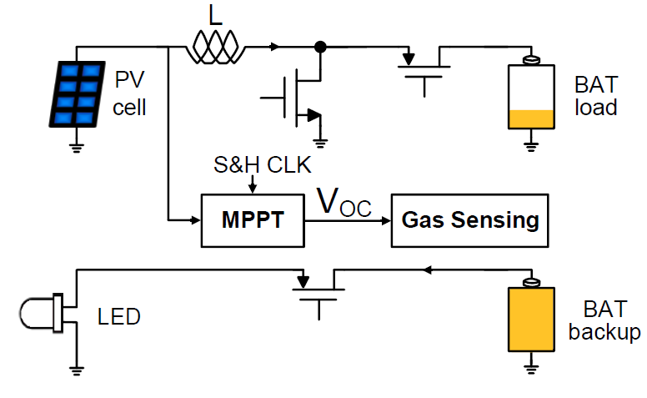
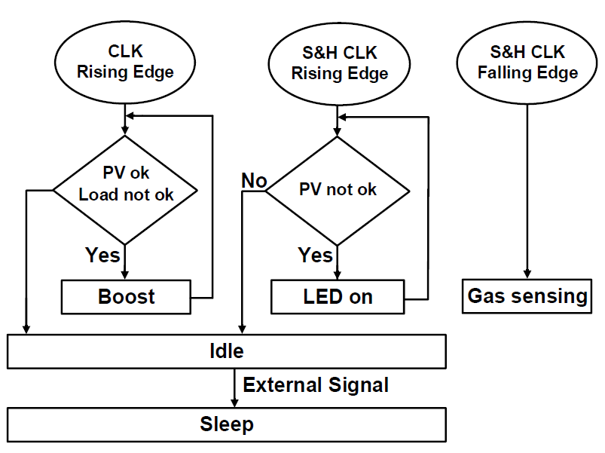
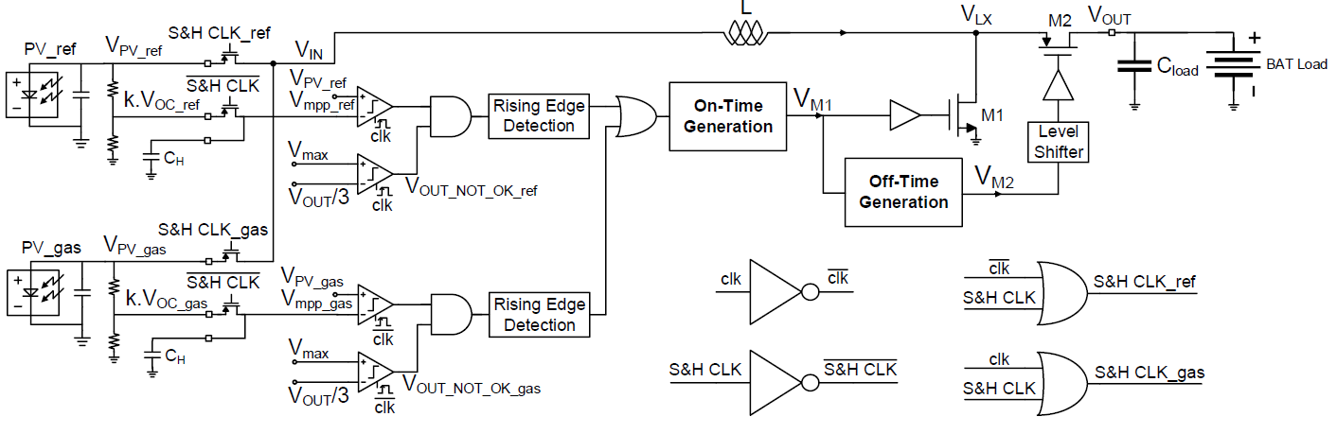

Self-Powered Gas Sensor IC Based on Photovoltaic Energy Harvesting
Phan Dang Hung and Minkyu Je
School of Electrical Engineering, Korea Advanced Institute of Science and Technology (KAIST)
E-mail: hungphandang@kaist.ac.kr
Introduction – Self-Powered Gas Sensor System
Structure of colorimetric sensor
Conventional portable gas sensing device
Proposed self-powered gas sensor
• Sensor consists of a gas sensitive layer and a polymer layer [1].
• Color of gas sensitive layer is changed when exposing to gases.
• Gas concentration is measured based on the change of color.
• LED works as a light source in the sensor.
• Photo diode (PD) measures the amount of light passing through the sensor.
• Gas concentration is measured based on the change of light received by PD.
• Sensor consists of a photovoltaic (PV) cell covered by a sensor film [2].
• Transparency of the sensor film is changed when exposing to gases.
• Gas concentration is measured based on the output current or voltage of the PV cell.
Circuit Implementation
Simplified system configuration
Operation scenario of the system
Gas signal processing diagram
Dual-input shared-inductor boost control circuit
• System consists of a PV cell covered by the sensor film (PV_gas) and a reference PV cell (PV_ref) to conduct differential gas sensing.
• Dual-input shared-inductor boost converter is implemented to improve the power efficiency when exposing to gases.
• Gas signal processing function is seamlessly embedded within energy harvesting circuits.
• Offset cancellation is performed in gas signal processing circuits to provide accurate gas-sensing readout without any external trimming.
Measurement Results
Measurement setup
End-to-end efficiency
Efficiency with the different gas concentration
Sensor sensitivity
• The gas sensor consisting of the PV cell covered by the sensor film is placed in a gas chamber, and the ambient light inside the chamber is controlled by the LED.
• The energy harvesting circuits using dual-input shared-inductor boost converter achieves a peak end-to-end efficiency of 88% and maintains the efficiency of more than 75% from 100μW to 4mW.
• The dual-input shared-inductor converter shows up to 11% end-to-end efficiency improvement at 2% H₂ concentration compared to the single-input converter with two PV cells connected in parallel.
• From the real-time gas sensing test, the ADC output code are obtained with varying the H₂ concentrations (0.1%, 0.5%, 1%, 1.6%, and 2%).
Acknowledgement
This work was supported by the Ministry of Science and ICT, Korea under the ITRC Program (IITP-2020-0-01778) and the DGIST R&D Program (21-IJRP-01).
References
[1] M. Alexy et al, “Disposable optochemical sensor chip for nitrogen dioxide detection based on oxidation N,N′-diphenyl-1,4-phenylenediamine”, Sens. Actuator B-Chem., vol. 114, pp. 916–927, 2006.
[2] M.-H. Seo et al, “Chemo-Mechanically Operating Palladium-Polymer Nanograting Film for a Self-Powered H₂ Gas Sensor,” ACS Nano, vol. 14, no. 12, pp. 16813-16822, 2020.

